Slide 1


PHAN NGOC ANH
Supervisor: Dr Nguyen Dang Tue
This presentation is prepared for academic purposes of the Financial Investment course at HUST only and does not constitute financial advice, investment recommendation, or professional consulting.

Slide 2




The form of Warner Bros. Discovery
M&A deal
Multiple Strategic Shift
2022: TWC + Discovery= WBD
2023-2025: Rebound
3 CORE SEGMENTS
Studios
Networks
Direct-to-Consumer (DTC)
MONETIZATION FOCUS:
Distribution
Advertising
Content Licensing.
A glimpse
Question
Is WBD burning in debt after the merger? Can they meet their obligations?
Financial Benchmarking
Peer Matrix
Liquidity
Solvency
Valuation
Outlook
With a 4% growth in sales, EFN & Fixed Asset Can Spike Unexpectedly
EXECUITVE
INTRODUCTION
FINANCIAL BENCHMARKING
FINANCIAL PLANING
CONCLUSION

Slide 3
The form of Warner Bros. Discovery
It is no longer being “Time Warner”
Strategic Move:
Gross Profit and Ticket Sold (1995-2025)
1990
Time Inc. merged Warner Communication= Time Warner
Dominant in publishing + entertainment
=> A traditional media giant.
2001
AOL aquired Time Warner
Combine old media (TV, film) with new media (internet).
=> poorly executed => losses.
2008
Time Warner separates from AOL
Refocus on core entertainment (film, TV, publishing).
=> Strategic unwinding
2018
AT&T acquired Time Warner
Combine content (Time Warner) with distribution (telecom services). (Horizontal integration)
Market share and IP Produce (1995-2025)
2021
AT&T spin off WarnerMedia and merge with Discovery
Due to debt pressure and lack of synergy, focused content powerhouse without telecom distractions.
2022
WarnerMedia + Discovery = Warner Bros. Discovery
Platform unification + IP leverage.
=> Compete in the global streaming wars
EXECUITVE
INTRODUCTION
FINANCIAL BENCHMARKING
FINANCIAL PLANING
CONCLUSION

Slide 4


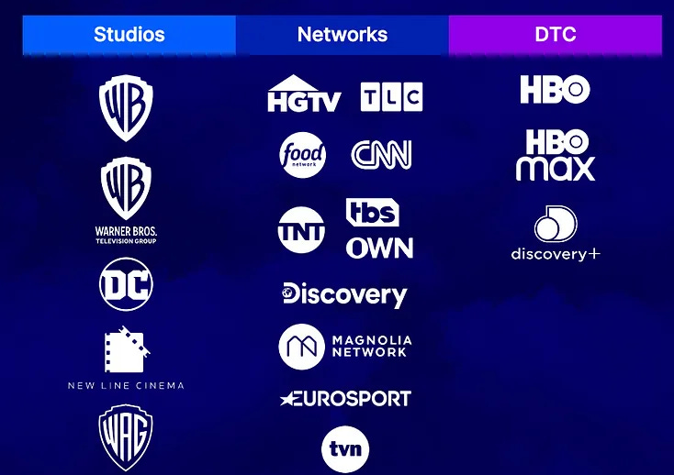
WBD’s core
3 segments
Revenue by segments
Studios: Film & Television Production, Distribution, Consumer Products, Gaming.
51,3 %- cash engine.
Networks: Domestic & International Television Networks
Racing in the Streaming War
Direct-to-Consumer (DTC): Streaming & Premium Services
Segment | Monetization Models:
Networks | Advertising (linear TV ads) Affiliate Fees from cable/satellite providers
Studios | Box Office Sales (for theatrical releases) Licensing to platforms (e.g., Netflix) TVOD/EST (pay-per-view or sell-through digital content)
Streaming (DTC) | SVOD (monthly/yearly subscriptions via Max) AVOD (ads on ad-supported plans)
Distribution
Advertising
Content
EXECUITVE
INTRODUCTION
FINANCIAL BENCHMARKING
FINANCIAL PLANING
CONCLUSION

Slide 5
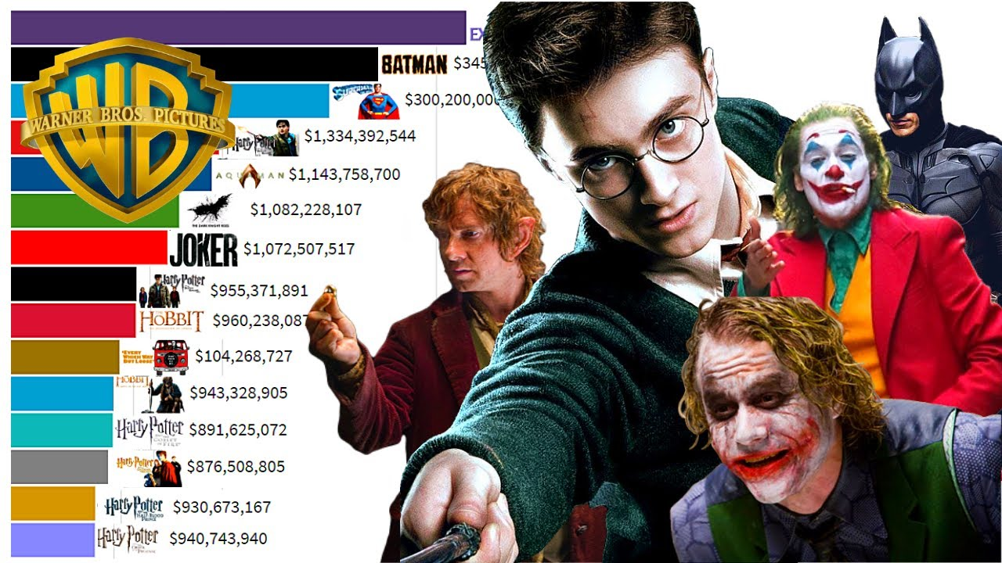
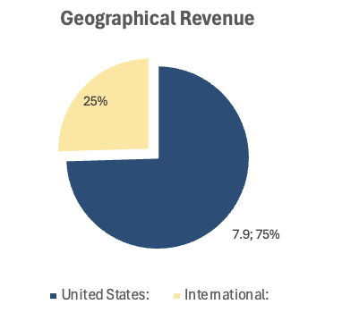
WBD’s core
Most Valuable IPs (2024)
Revenue by function
Strength | Weakness | Opportuinity | Thread
World-Class IP Portfolio: Harry Potter, Game of Thrones, DC Universe, Friends Studio scale: Warner Bros. Pictures = one of the “Big Five” studios in Hollywood Brand Trust in News & Non-Fiction Closed Value Chain | Dependence on Linear TV: Still heavily reliant on declining segments like cable and broadcast Strategic Uncertainty: Post-merger integration of HBO Max & Discovery+ into Max caused: Confusion around positioning (premium vs. lifestyle) | Opportunity to expand via: Games (e.g. Hogwarts Legacy success) Consumer products & live events Theme parks or licensed attractions Mobile-first & interactive content (AI, VR) | AI-driven content creation Cord-Cutting Trend: Accelerates decline in linear revenue (advertising + affiliate fees)
EXECUITVE
INTRODUCTION
FINANCIAL BENCHMARKING
FINANCIAL PLANING
CONCLUSION

Slide 6
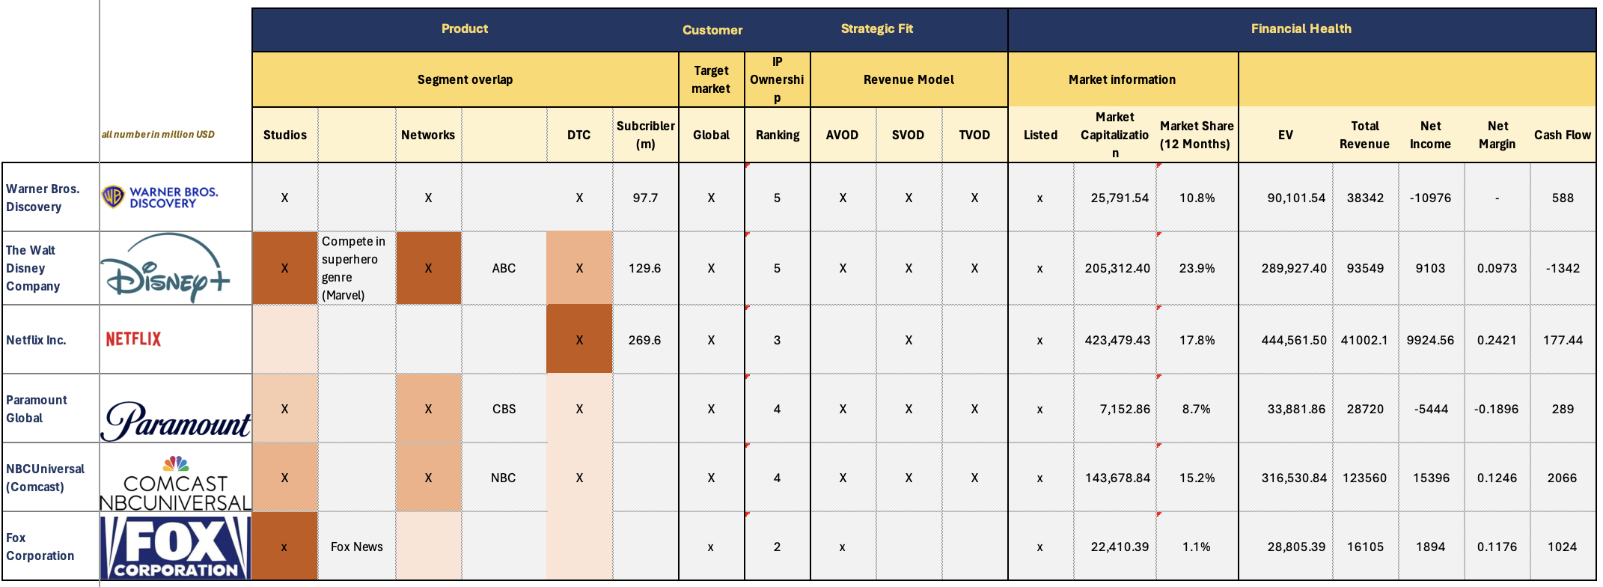

Peer Selection
Advertising Video On Demand (AVOD): ads, free content.
SVOD: pay a recurring fee (monthly/yearly) to access unlimited content, ad-free
TVOD (Transactional Video On Demand): pay per title
Rank | Meaning
5 | Global, multi-billion-dollar franchises
4 | Strong global franchises, but less diversified
3 | Notable IPs, less globally iconic / fewer franchises
2 | Regional or format-based IPs
1 | No meaningful entertainment IPs
EXECUITVE
INTRODUCTION
FINANCIAL BENCHMARKING
FINANCIAL PLANING
CONCLUSION

Slide 7


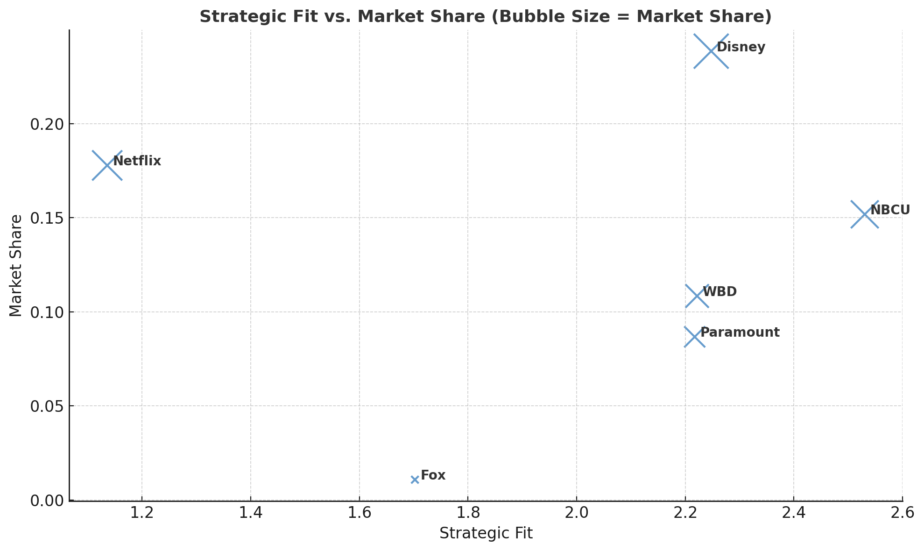


With Peer Score = Segment * 40% + Global presence*10% + Revenue Model*20%+ IP ranking*30%
Creating a streaming war with the largest subscriber base.
Digital-native with a focus on original global IP.
But doesn’t cross all segments
Peer Selection Matrix
Strong in scripted content (e.g., Star Trek, CBS).
Lowest content output among peers.
Competes across all segments like WBD.
NBCU belongs to Comcast, whose core business is internet pipes, not media & entertainment.
=> Hard to compare
Avoids streaming, focuses on news and live sports.
=> Content enrichment & user retention strategy
Profitable through a traditional, ad-supported model.
=> Proof that out of streaming war is still alive
Doesn’t have the same revenue model
Similar structure: active in streaming, networks, and studios.
Stronger IP (e.g., Marvel), integrated theme parks, and better financial health.
Higher financial health
Peer score

Slide 8
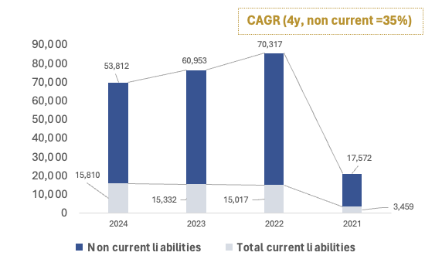
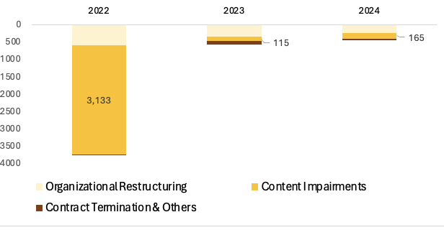


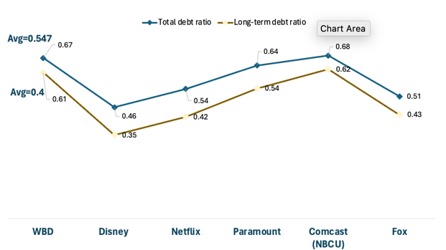
WBD’s Market Perception
“WBD is burning in debt! ”- Yahoo Finance
Merger deal
Post-merger investment
Debt Structure
1. WBD took on the debt burden after the 2022 merger
=> A 300% increase in total debt compared to 2022
Industry’s nature = No inventory
Have intellectual property (IP), content libraries, and programming rights as long-term assets or intangible asset
70% debt is long-term debt
All debts are senior notes
EXECUITVE
INTRODUCTION
FINANCIAL BENCHMARKING
FINANCIAL PLANING
CONCLUSION

Slide 9
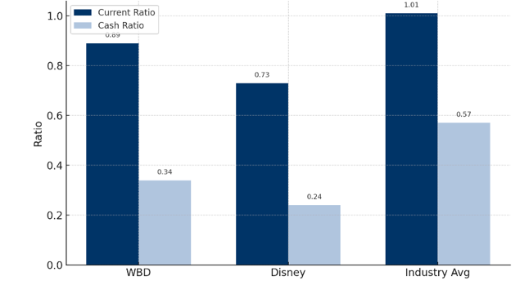
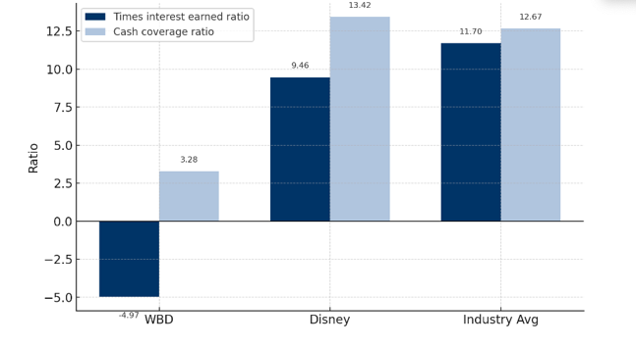
Can WBD Meet Its Short-Term Obligations?
Current & Cash Ratio
Outperforms Disney in short-term liquidity, higher current ratio (0.89 vs. 0.73) & stronger cash ratio (0.34 vs. 0.24).
But WBD lags behind the industry average.
Item | Value (USD Billion)
Liquidity Headroom | 11.31 (6.01 + 5.31)
Current Liabilities (2024) | 15.81
Liquidity Shortfall | –3.50
Time Interest Earned ratio & Cash Coverage Ratio
WBD executed a multi-pronged strategy to improve TIE in 2024:
Retired high-interest debt, issued lower-interest bond
Retired $3.4B of long-term bonds with 5.30% interest via tender offer, saving future interest costs and booking a $542M gain. And 2 long-term new bonds issued: 4.302% vs 4,693% interest rate
(2) Monetized non-core assets to enhance cash on hand: Sold equity stakes in All3Media and Formula E, generating over $500 m in cash
While WBD cannot immediately cover all short-term liabilities with available liquidity, it is not in a liquidity crisis.
Strategic debt restructuring and asset monetization indicate positive steps toward restoring solvency.
EXECUTIVE
INTRODUCTION
FINANCIAL BENCHMARKING
FINANCIAL PLANING
CONCLUSION

Slide 10
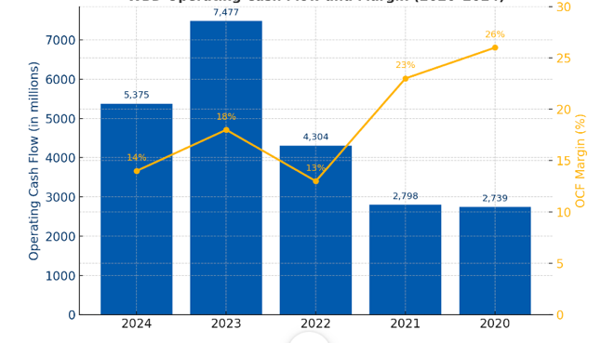
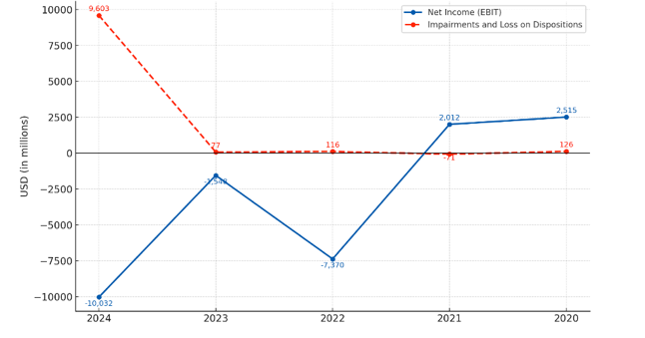
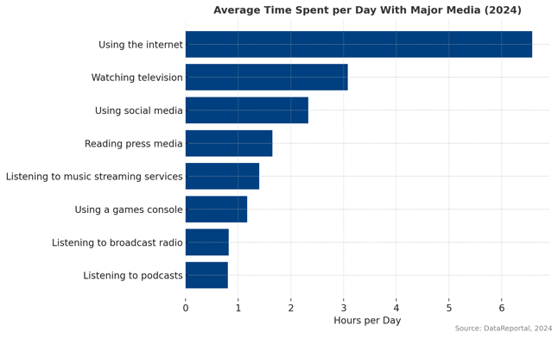

Evaluating WBD’s Long-Term Debt Servicing Ability
Operating Cash Flow
Decrease OCF due to - $9.1B goodwill impairment.
The Average Day Spent watching television decreases, 2024
Uncertainty regarding
The renewal of famous basketball broadcasting rights
EXECUTIVE
INTRODUCTION
FINANCIAL BENCHMARKING
FINANCIAL PLANING
CONCLUSION

Slide 11
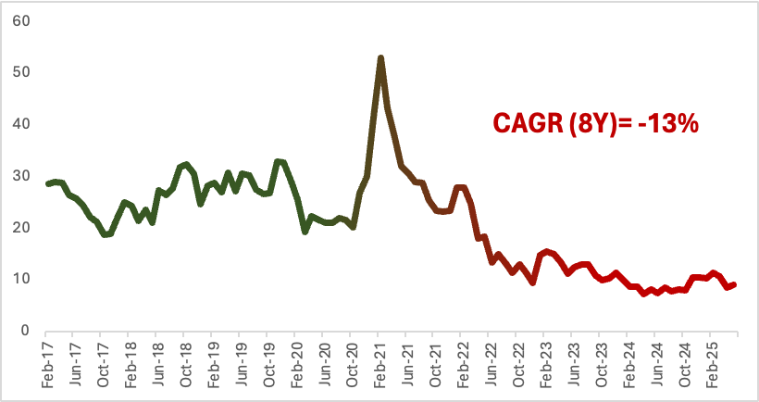
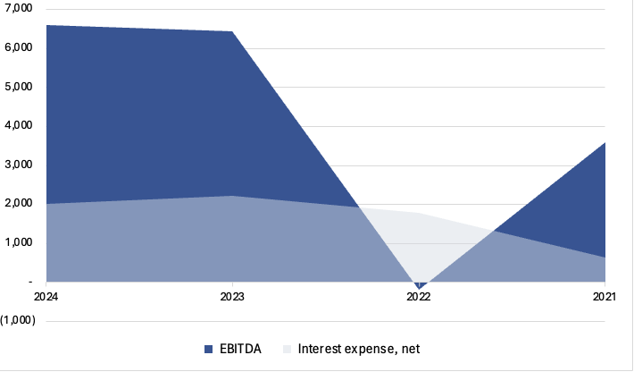
Evaluating WBD’s Long-Term Debt Servicing Ability
Drop in fair price
Impairment loss due to drop in fair price
[1] Macroeconomic factor
[2] Specific-segement challenging
EBITDA/ Interest expense
Non-cash in nature, excluded from EBITDA
=> Interest Coverage Ratio remains strong at 3.28, indicating debt remains serviceable.
Despite negative market sentiment, WBD maintains sufficient long-term interest-paying capacity.
While leverage is high, there is no immediate bankruptcy risk.
Needed to control non-operating and one-time items
EXECUTIVE
INTRODUCTION
FINANCIAL BENCHMARKING
FINANCIAL PLANING
CONCLUSION

Slide 12
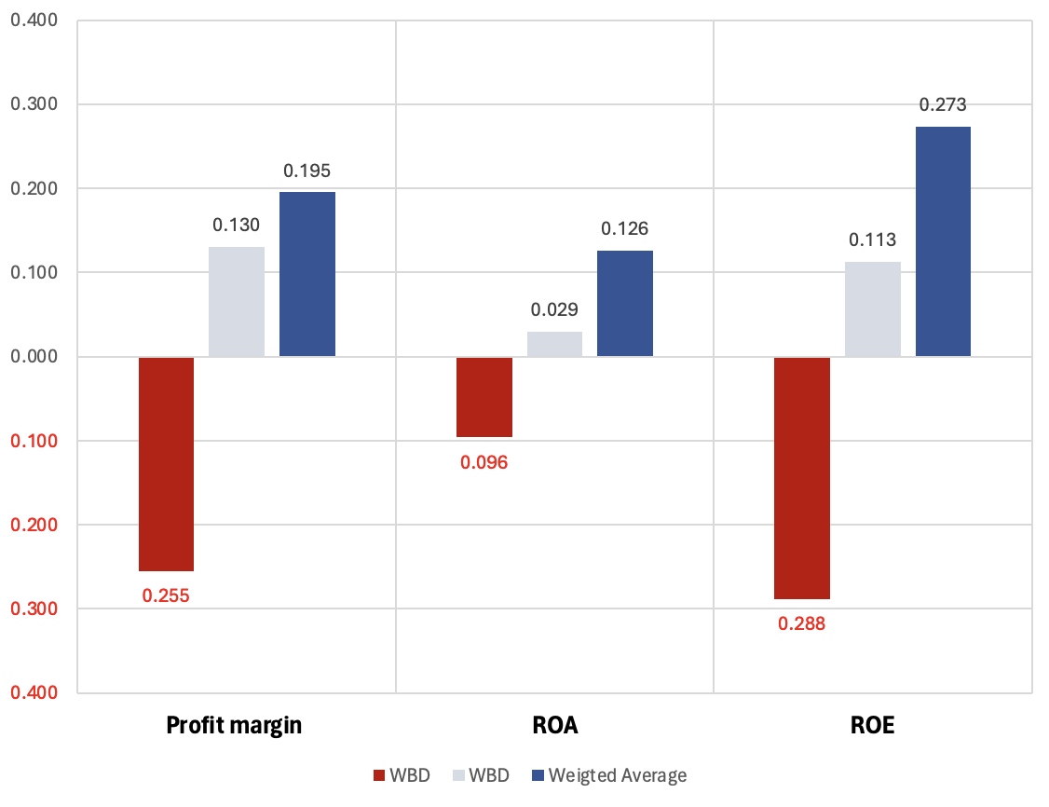
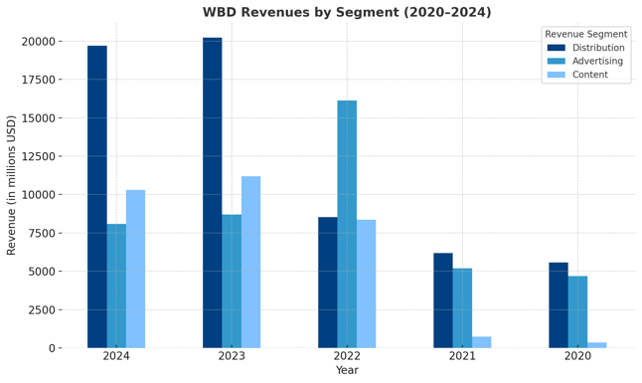
What’s Behind WBD’s Low Valuation? Is capital used efficiently?
Profitability Ratio
Revenue segment stream
Average Day Spent with major media, 2024
Advertising: Down 7% overall, audiences are shifting to digital platforms =>harder for WBD to capture ad revenue
Content: Lower revenue due to lack of blockbuster titles in 2024 compared to 2023 hits like Hogwarts Legacy — not operational weakness, but a tough year-on-year comparison.
Distribution: Continued decline from cord-cutting and shrinking affiliate fees. Gains in DTC (e.g., Max) couldn’t fully offset losses in linear TV.
EXECUTIVE
INTRODUCTION
FINANCIAL BENCHMARKING
FINANCIAL PLANING
CONCLUSION

Slide 13
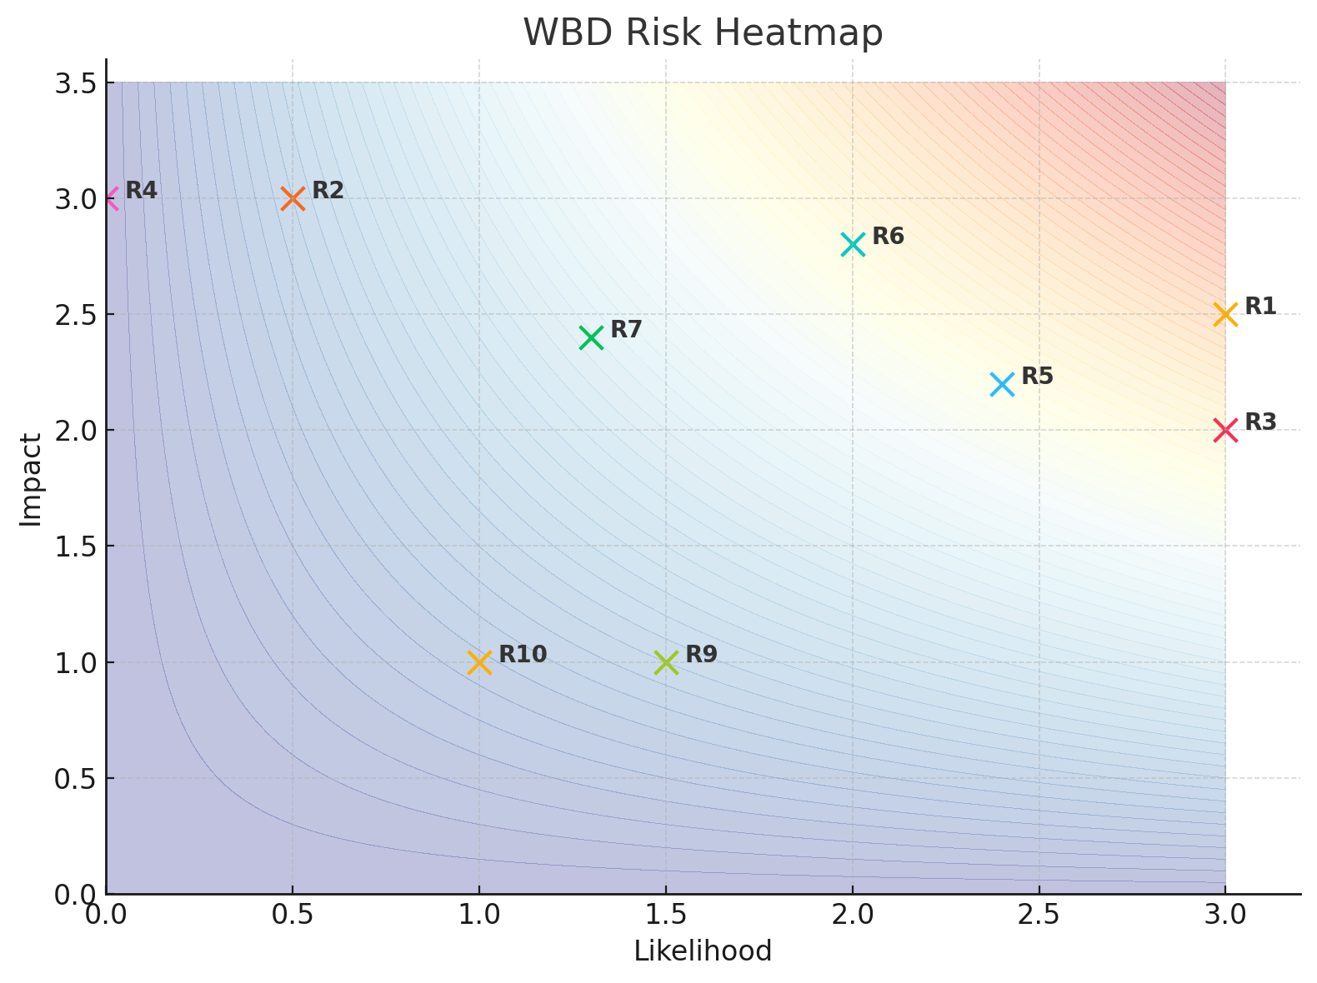
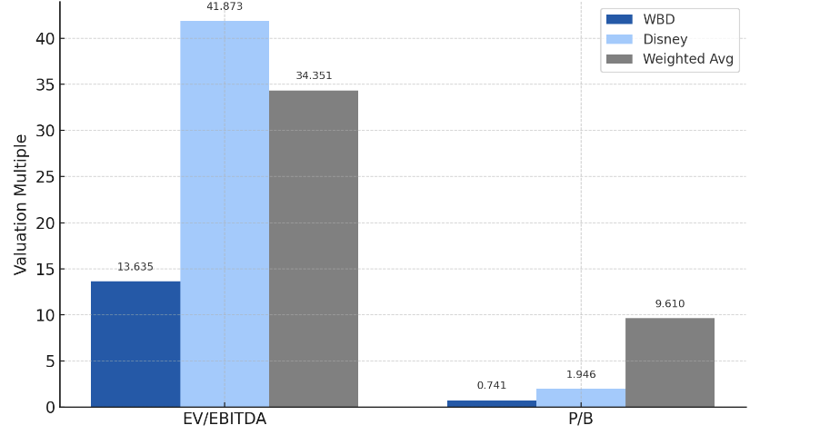
What’s Behind WBD’s Low Valuation? Is capital used efficiently?
WBD risk map
Impact
Likelihood
R1. High Leverage Risk | 2.5 | 3
R2. Earnings Volatility | 3 | 0.5
R3. Failure to Renew Distribution Licenses | 2 | 3
R4. Audience Fragmentation | 3 | 0
R5. Content Cycle Dependence | 2.2 | 2.4
R6. Distribution Erosion | 2.8 | 2
R7. Streaming Competition | 2.4 | 1.3
R8. Macroeconomic Sensitivity | 1 | 1.5
R9. Regulatory/Geopolitical | 1 | 1
See more in Appendix 2
EV/EBITDA, P/B
1. WBD earns consistent revenue, but negative profit margins mean earnings don’t translate into equity.
=> P/E and P/S are not useful valuation tools.
=> EV/EBITDA and P/B are more appropriate.
2. WBD trades at a lower EV/EBITDA and below book value vs. Disney and the industry average.
=> Lower growth prospects, higher perceived business and financial risk
EXECUTIVE
INTRODUCTION
FINANCIAL BENCHMARKING
FINANCIAL PLANING
CONCLUSION

Slide 14
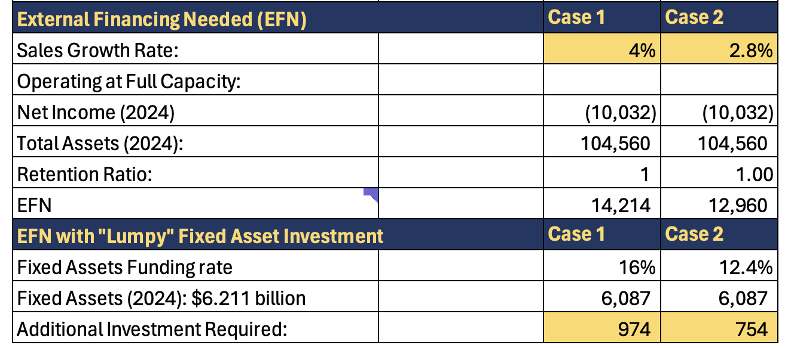
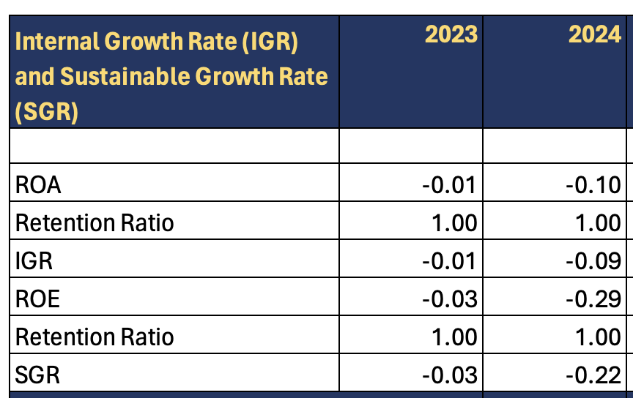
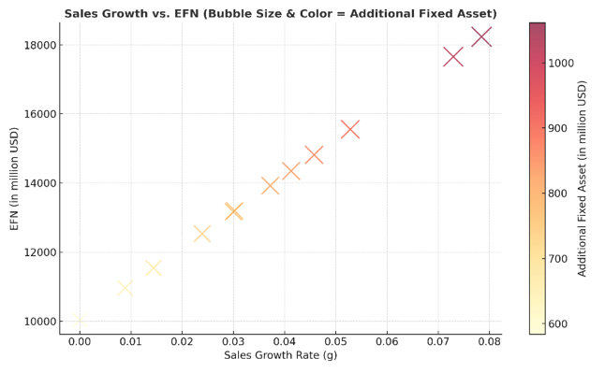
Future Outlook
IGR & SGR Analysis for WBD (2023–2024)
WBD cannot support any sales growth without external financing, and even maintaining current operations may require additional funding.
Capital Pressure Zone
(Bubble Size & Color = Additional Fixed Asset)
WBD’s EFN tolerance threshold is ~$ 13.8 B.
Planning a 4% increase in sales with $ 14,214 billion EFN is not recommended
WBD historically generates $5B–$7.5B in OCF, meaning $13B EFN could be covered internally in ~2 years.
$13B represents <15% of total assets.
It signals not overexpansion (growth in the firm’s internal financial capacity)
It increases the risk of entering a debt spiral, where new borrowing is required to sustain previous growth.
=> Increasing 2.8% in sales, with $12.9 B in EFN, 754m in fixed asset
EXECUTIVE
INTRODUCTION
FINANCIAL BENCHMARKING
FINANCIAL PLANING
CONCLUSION

Slide 15

KEEP ON
“DISCOVERING”
Standing at a critical crossroads!
The company struggles with profitability, high leverage, and structural shifts in media consumption despite holding one of the industry’s most powerful content portfolios and maintaining consistent revenue through diversified streams
Its financials are weighed down by non-cash impairments, declining linear TV performance, and a lack of blockbuster content in 2024. As a result, traditional valuation metrics like P/E and P/S fall short, and the market now prices WBD conservatively through low EV/EBITDA and P/B multiples, reflecting investor concern over growth and risk.
However, WBD retains a strong interest coverage ratio, healthy liquidity buffers, and historically robust operating cash flows. The current pressure is real, but the company is not in immediate financial danger.
To move forward, WBD must: [1] Refocus capital toward high-return IP and global content [2]Expand international DTC (especially AVOD) [3] Manage fixed asset expansion cautiously [4] Prioritize restoring profitability to reduce external funding needs
“WBD is not a story of collapse—it’s one of recalibration.”

Slide 16
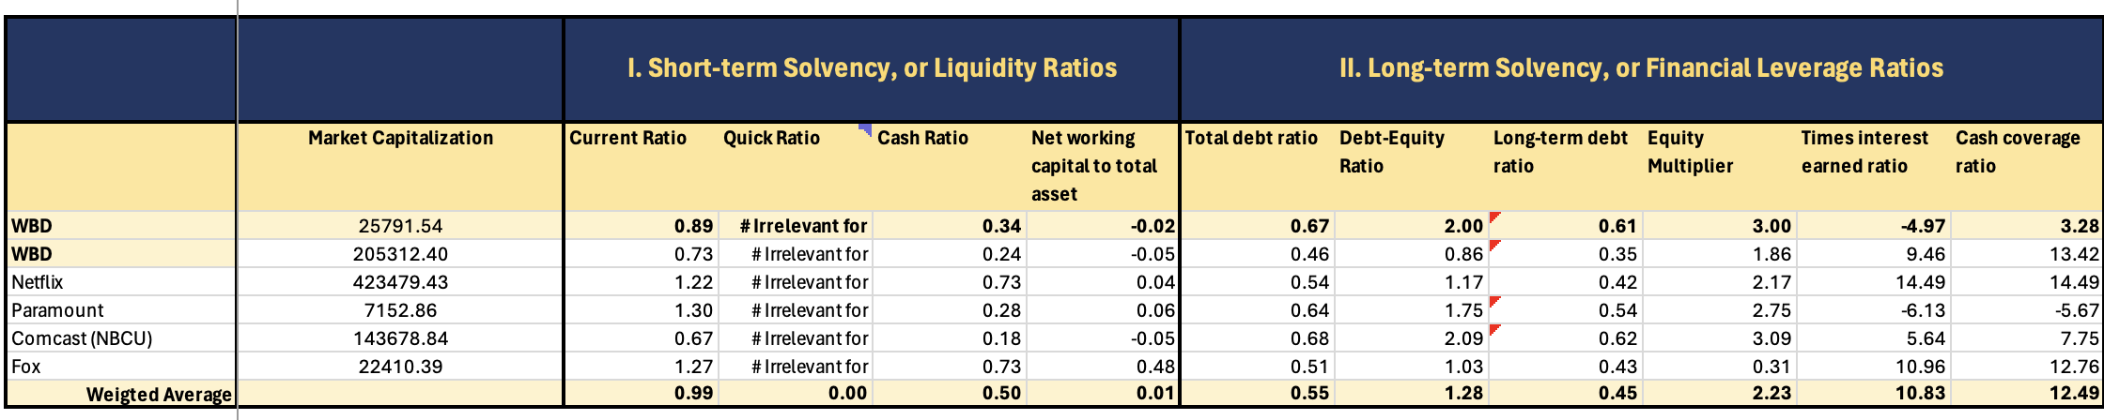
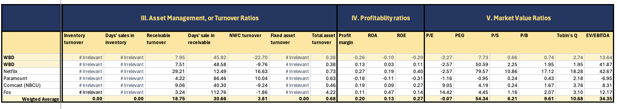
Appendix 1: Comparable Analysis

Slide 17
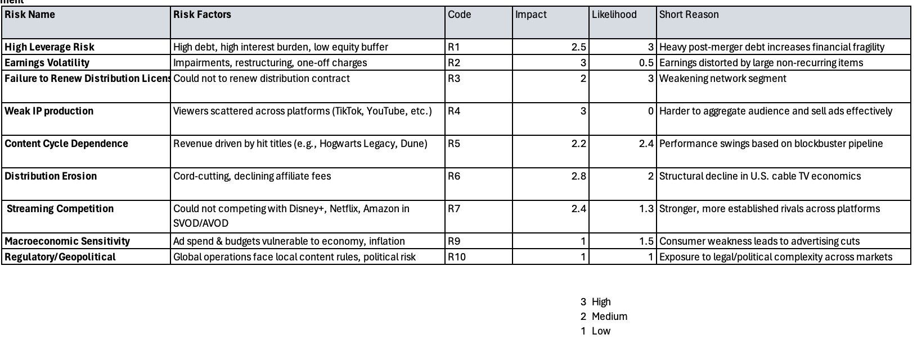
Appendix 2: Risk Measurement

Slide 18
REFFERENCE:
Bloomberg. (2024). Warner Bros. Discovery M&A history and deal analysis. Retrieved from https://www.bloomberg.com
DataReportal. (2024). Digital 2024: Global Overview Report. Retrieved from https://datareportal.com/reports/digital-2024-global-overview-report
The Retail Deep Dive. (2024). Business model visualization of media companies. Retrieved from https://www.theretaildeepdive.com
The Numbers. (2024). Warner Bros. ticket sales and movie releases, 1990–2024. Retrieved from https://www.the-numbers.com
Yahoo Finance. (2024). WBD stock commentary and financial metrics. Retrieved from https://finance.yahoo.com
Warner Bros. Discovery. (2024). 2024 Annual Report. Retrieved from https://ir.wbd.com
Warner Bros. Discovery. (2023). 2023 Annual Report. Retrieved from https://ir.wbd.com
Warner Bros. Discovery. (2022). 2022 Annual Report. Retrieved from https://ir.wbd.com
Warner Bros. Discovery. (2021). 2024 Annual Report. Retrieved from https://ir.wbd.com
Warner Bros. Discovery. (2020). 2024 Annual Report. Retrieved from https://ir.wbd.com
Warner Bros. Discovery. (2024). Q1 2025 Earnings Release. Retrieved from https://ir.wbd.com
Author’s analysis. (2025). All financial modeling, Monte Carlo simulation, and visualizations performed using Excel and Python for educational purposes.
Obrela. (2024). Global digital and media usage statistics. Retrieved from https://obrela.com
Nielsen. (2024). Audience measurement and media trends in streaming. Retrieved from https://www.nielsen.com
Moody’s Investors Service. (2024). Warner Bros. Discovery, Inc. Credit Opinion. Retrieved from https://www.moodys.com
Statista. (2024). Global SVOD and AVOD user penetration statistics. Retrieved from https://www.statista.com
PwC. (2024). Global Entertainment & Media Outlook 2024–2028. Retrieved from https://www.pwc.com

